Slide 1
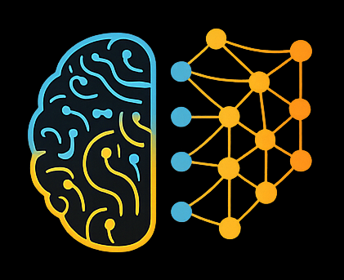

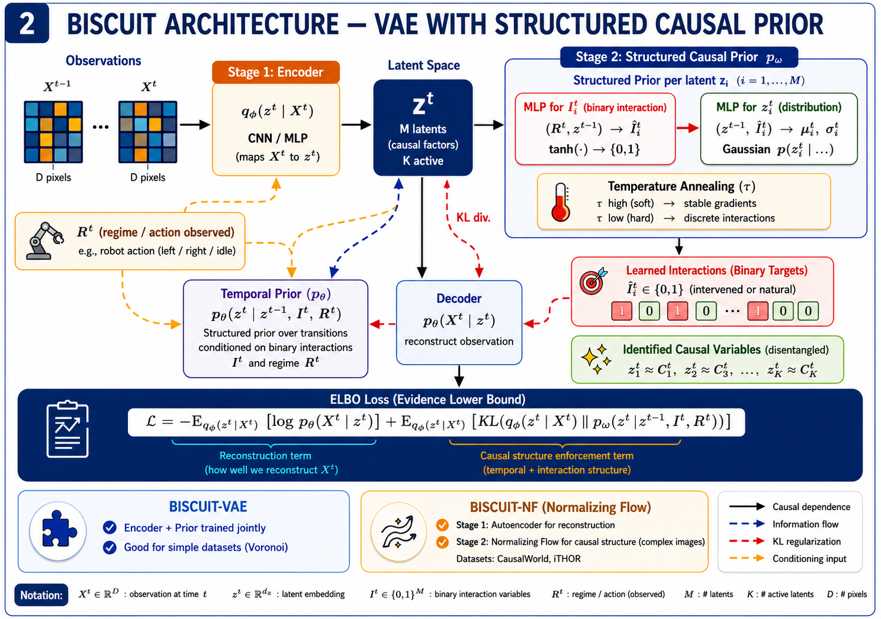
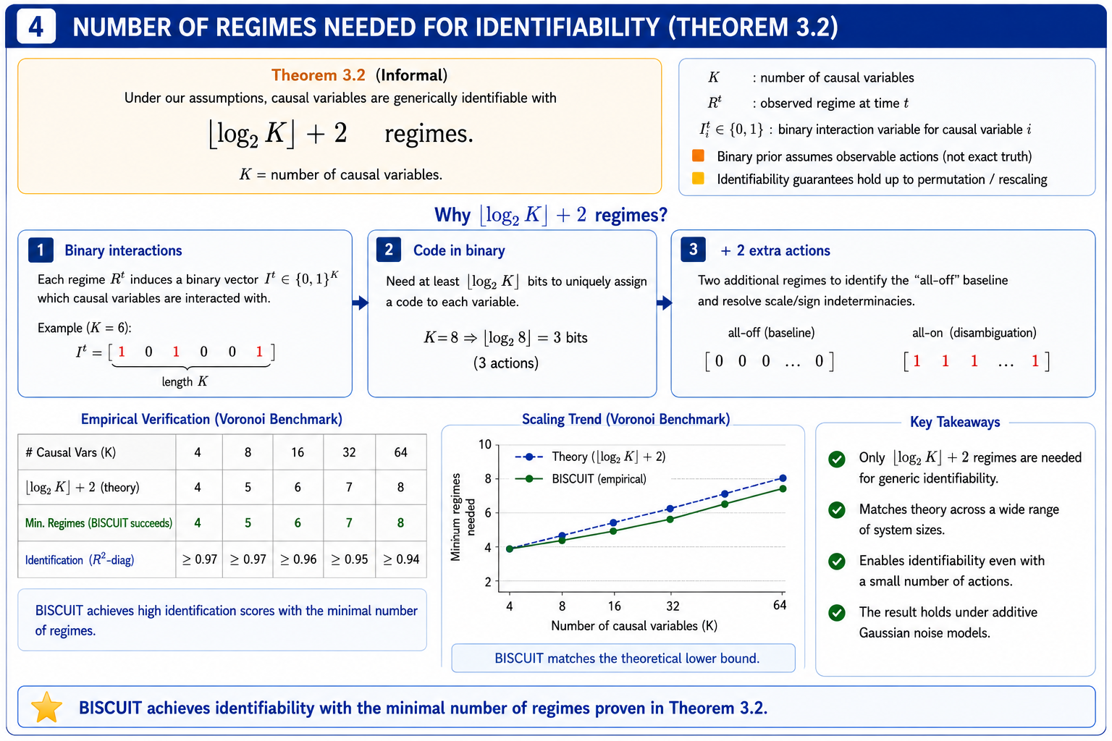
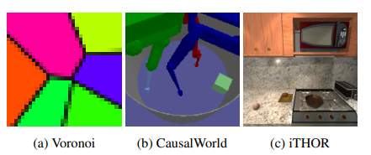
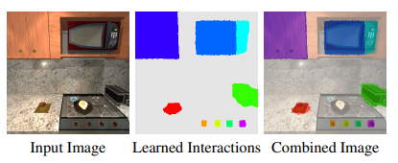
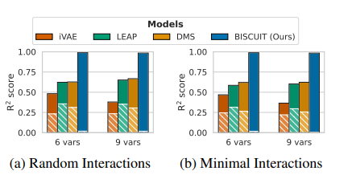
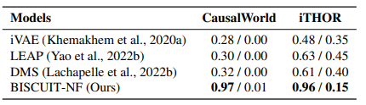
Latent Space Interventions
BISCUIT: Causal Representation Learning from Binary Interactions
Generative and Deep Learning Course 2025/2026 - University of Pisa
1. Introduction
2. Approach
Problem: Learning compact, disentangled causal representations from high-dimensional observations (e.g., images) in interactive environments (robotics, embodied AI) is crucial but hard. Agents interact with the world but their interaction targets are unknown.
Gap: Prior methods either require known intervention targets (supervision), many regime variables (linear scaling with K), or fail on common models like additive Gaussian noise.
Contribution: BISCUIT theoretically shows that causal variables are identifiable when each variable is associated with a binary interaction variable. It jointly learns causal variables and their unknown binary interaction targets — with as few as log₂(K)+2 distinct actions.
Causal Model: K latent causal variables C₁,...,Cₖ evolve over time (dynamic Bayesian network). Each variable has a latent binary interaction variable ∈ {0,1} that selects between two mechanisms — observational or interventional — driven by an observed regime variable R𝑡 (e.g., robot action).
Identifiability: Variables are identifiable (up to permutation and element-wise transforms) if each has a distinct interaction pattern (no two always co-activated), and the log-likelihood difference Δ(C𝑖|C𝑡⁻¹) varies in dynamics or time.
Architecture: BISCUIT is a VAE (encoder/decoder + structured prior). The prior uses per-variable MLPs: one predicts I𝑖 from (R𝑡, z𝑡⁻¹) via temperature-scaled tanh; another predicts p(z𝑖𝑡 | z𝑡⁻¹, I𝑖). BISCUIT-NF separates autoencoder and normalizing-flow stages for visually complex scenes.
3. Experiments
4. Personal considerations
Datasets:
1. Voronoi: Synthetic benchmark, additive Gaussian noise, 6 or 9 causal variables, robotic arm as regime;
2. CausalWorld: Tri-finger robot manipulating a cube in 3D. Tests robustness, as real interactions are not strictly binary (depend on velocity, rotation, etc.).
3. iTHOR: Realistic environment with 18 causal variables (embodied AI). Conditional variable states depends on previous variables interaction (time dependency)
Metric & baselines:
R²-diag (higher=better) measures alignment of learned latents to true causal variables; R²-sep (lower=better) measures spurious correlations. Compared against iVAE, LEAP, and DMS.
Results:
1. Voronoi: BISCUIT reliably recovers causal variables even with the minimum interaction regimes.
2. CausalWorld: BISCUIT-NF does not only reconstruct the image, but also separates the main causal variables. It also learns to recognize whether a robot-cube collision occurs.
3. iTHOR: BISCUIT mainly struggles with egg and plate because they are highly correlated in the environment. However, it shows a modular representation, because it can combine latents from two images and generate new states, such as raw egg + stove on, generating a novel state.
Assumptions & Limitations: The theory requires strictly binary interactions. Real-world agents often have graded, continuous, or multi-state effects. The distinct interaction pattern assumption (no two variables always co-activated) can be hard to guarantee in practice. The regime variable R𝑡 must be observable, which may not always hold.
Responsible AI: Causal representations learned without supervision could encode spurious correlates from biased training environments. Deploying such models in robotics or embodied AI requires careful auditing of what variables are learned and whether they reflect true causal structure.
Lessons learned: Binary structure is a surprisingly powerful inductive bias — it breaks the rotational invariance that makes additive Gaussian noise models hard. Future work: extend to partial identifiability, sparse/continuous interactions, and longer temporal dependencies.
Three environments with increasing complexity:
Learned Interaction Variables
R² scores for the identification of causal variables
Lippe P., Magliacane S., Löwe S., Asano Y.M., Cohen T., Gavves E. — BISCUIT: Causal Representation Learning from Binary Interactions. UAI 2023, PMLR 216:1263–1273.
Generative and Deep Learning Course · University of Pisa

